Slide 1
CS-205 Data Structure and Algorithms
7. Stacks
Weihao Qu
Monmouth University

Slide 2
Abstract data type (ADT)
An abstract data type (ADT) is an abstraction of a data structure
An ADT specifies:
  Data stored
  Operations on the data
  Error conditions associated

Slide 3
ADT
Example: ADT modeling a simple stock trading system
The data stored: buy/sell orders
The operations supported are
  order buy(stock, shares, price)
  order sell(stock, shares, price)
  void cancel(order)
Error conditions:
  Buy/sell a nonexistent stock
  Cancel a nonexistent order

Slide 4
Stack ADT
The Stack ADT stores arbitrary objects
Insertions and deletions follow the last-in first-out scheme
Main stack operations:
  push(object): inserts an element
  object pop(): removes and returns the last inserted element
Auxiliary stack operations:
  object top(): returns the last inserted element without removing it
  integer size(): returns the number of elements stored
  Boolean isEmpty(): indicates whether no elements are stored

Slide 5
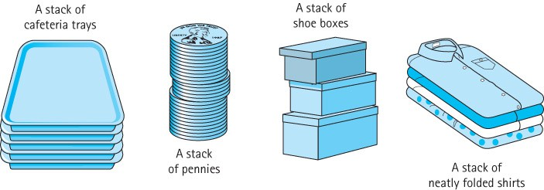
Stacks
Stack A structure in which elements are added and removed from only one end; a “last in, first out” (LIFO) structure

Slide 6
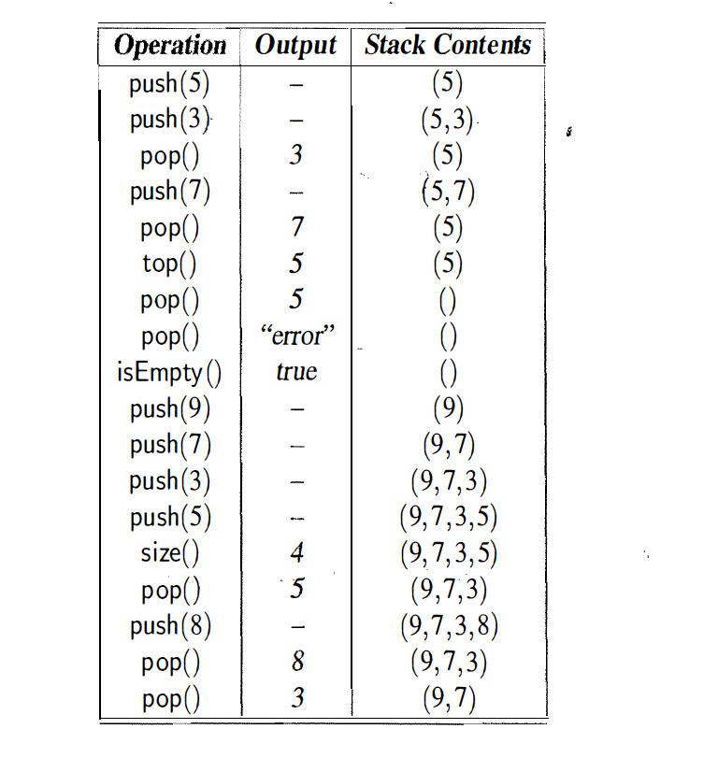
Example

Slide 7
Applications of Stacks
Page-visited history in a Web browser
Undo sequence in a text editor
Chain of method calls in the Java Virtual Machine

Slide 8
Stack Interface in Java
Java interface corresponding to our Stack ADT
Requires the definition of class EmptyStackException
Different from the built-in Java class java.util.Stack
public interface Stack<E> {
public int size();
public Boolean isEmpty();
public E top() throws EmptyStackException;
public void push(E element);
public E pop() throws EmptyStackException;
}

Slide 9
Applications of Stacks
Direct applications
Page-visited history in a Web browser
Undo sequence in a text editor
Chain of method calls in the Java Virtual Machine
Indirect applications
Auxiliary data structure for algorithms
Component of other data structures
© 2014 Goodrich, Tamassia, Goldwasser

Slide 10
Performance and Limitations
Performance
  Let n be the number of elements in the stack
  The space used is O(n)
  Each operation runs in time O(1)
Limitations
  The maximum size of the stack must be defined a priori and cannot be changed
  Trying to push a new element into a full stack causes an implementation-specific exception
© 2014 Goodrich, Tamassia, Goldwasser

Slide 11
Exception
Attempting the execution of an operation may sometimes cause an error condition, called an exception
Exceptions are said to be “thrown” by an operation that cannot be executed
In the Stack ADT, operations pop and top cannot be performed if the stack is empty
Attempting the execution of pop or top on an empty stack throws an EmptyStackException

Slide 12
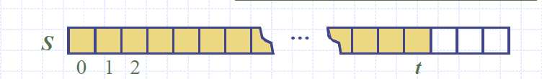
Array-based stack
A simple way of implementing the Stack ADT uses an array
We add elements from left to right
A variable keeps track of the index
Algorithm size()
return t + 1
Algorithm pop()
if isEmpty() then
throw EmptyStackException
else
o = S[t]
t = t -1
return o

Slide 13
Array-based stack
The array storing the stack elements may become full
A push operation will then throw a FullStackException
  Limitation of the array-based implementation
Not intrinsic to the Stack ADT
Algorithm push(o)
if t = S.length - 1 then
throw FullStackException
else
t = t + 1
S[t] = o

Slide 14
Performance
Performance
  Let n be the number of elements in the stack
  The space used is O(n)
  Each operation runs in time O(1)
Limitations
  The maximum size of the stack must be defined a priori and cannot be changed
  Trying to push a new element into a full stack causes an implementation-specific exception

Slide 15
Array-based stack in Java
public class ArrayStack<E> implements Stack<E> {
private E S[ ]; // holds the stack elements
private int top = -1; // index to top element
public ArrayStack(int capacity) { // constructor
S = (E[]) new Object[capacity]);
}
public E pop() throws EmptyStackException {
if isEmpty() throw new EmptyStackException (“Empty stack: no pop”);
E temp = S[top];
S[top] = null; // facilitate garbage collection:
top--; return temp;
}
//other methods of Stack interface
}

Slide 16
How to implement Stack with LinkedList
push()
pop()

Slide 17
Example use in Java
public class Test {
// … other methods
public intReverse(Integer a[]) {
Stack<Integer> s;
s = new ArrayStack<Integer>();
… (code to reverse array a) …
}
public floatReverse(Float f[]) {
Stack<Float> s;
s = new ArrayStack<Float>();
… (code to reverse array f) …
}
}

Slide 18
Exercise: parenthesis matching
Each “(”, “{”, or “[” must be paired with a matching “)”, “}”, or “]”
correct: ( )(( )){([( )])}
correct: ((( )(( )){([( )])}
incorrect: )(( )){([( )])}
incorrect: ({[ ])}
incorrect: (
Consider () only first
3+(4/6). Good
3+(4/6)+10). Bad

Slide 19
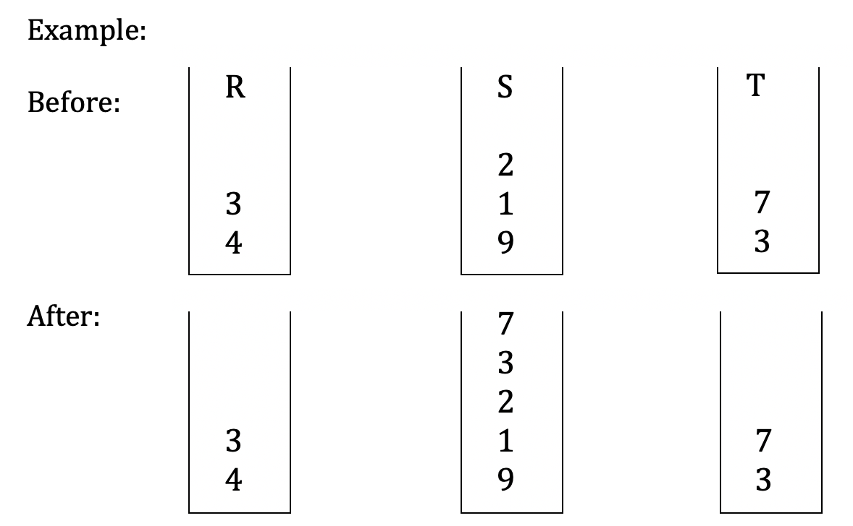
Exercise
Suppose you have three nonempty stacks R, S, and T that store integers. Implement a method that will add all elements in T to S in their original order. However, after the method call, all elements in R and T should appear unchanged.

Slide 20
Evaluating Arithmetic
Expressions
Slide by Matt Stallmann included with permission.
14 – 3 * 2 + 7 = (14 – (3 * 2) ) + 7
Operator precedence
* has precedence over +/–
Associativity
operators of the same precedence group
evaluated from left to right
Example: (x – y) + z rather than x – (y + z)
Idea: push each operator on the stack, but first pop and perform higher and equal precedence operations.

Slide 21
Algorithm for
Evaluating Expressions
Slide by Matt Stallmann included with permission.
Two stacks:
opStk holds operators
valStk holds values
Use $ as special “end of input” token with lowest precedence
Algorithm doOp()
  x ← valStk.pop();
  y ← valStk.pop();
  op ← opStk.pop();
  valStk.push( y op x )
Algorithm repeatOps( refOp ):
while ( valStk.size() > 1 ∧
prec(refOp) ≤ prec(opStk.top())
doOp()
Algorithm EvalExp()
  Input: a stream of tokens representing an arithmetic expression (with numbers)
  Output: the value of the expression
while there’s another token z
if isNumber(z) then
valStk.push(z)
else
repeatOps(z);
opStk.push(z)
repeatOps($);
return valStk.top()

Slide 22
Algorithm on an
Example Expression
Slide by Matt Stallmann included with permission.
Operator ≤ has lower precedence than +/–
14 ≤ 4 – 3 * 2 + 7
4
–
14
≤
3
*
$
$
4
–
7
$
14
≤
F
+
-2
+
5
+
14
≤
14
≤
2
2
3
*
3
*
6
4
–
4
–
4
–
-2
+
14
≤
14
≤
14
≤
14
≤

Slide 23
Computing Spans (not in book)
Using a stack as an auxiliary data structure in an algorithm
Given an an array X, the span S[i] of X[i] is the maximum number of consecutive elements X[j] immediately preceding X[i] and such that X[j] ≤ X[i]
Spans have applications to financial analysis
  E.g., stock at 52-week high
X
6 | 3 | 4 | 5 | 2
1 | 1 | 2 | 3 | 1
S

Slide 24
Quadratic Algorithm
Algorithm spans1(X, n)
Input array X of n integers
Output array S of spans of X #
S ← new array of n integers n
for i ← 0 to n − 1 do n
s ← 1 n
while s ≤ i ∧ X[i − s] ≤ X[i] 1 + 2 + …+ (n − 1)
s ← s + 1 1 + 2 + …+ (n − 1)
S[i] ← s n
return S 1
Algorithm spans1 runs in O(n²) time

Slide 25
Computing Spans with a Stack
We keep in a stack the indices of the elements visible when “looking back”
We scan the array from left to right
  Let i be the current index
  We pop indices from the stack until we find index j such that X[i] < X[j]
  We set S[i] ← i − j
  We push x onto the stack

Slide 26
Linear Time Algorithm
Each index of the array
  Is pushed into the stack exactly one
  Is popped from the stack at most once
The statements in the while-loop are executed at most n times
Algorithm spans2 runs in O(n) time
Algorithm spans2(X, n) #
S ← new array of n integers n
A ← new empty stack 1
for i ← 0 to n − 1 do n
while (¬A.isEmpty() ∧
X[A.top()] ≤ X[i] ) do n
A.pop() n
if A.isEmpty() then n
S[i] ← i + 1 n
else
S[i] ← i − A.top() n
A.push(i) n
return S 1

Slide 27
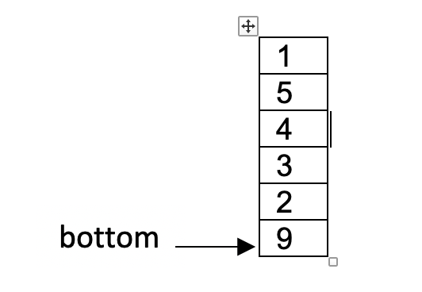
Exercise
Implement a method that puts each digit of a randomly generated integer into a stack, such that the most significant digit is at the bottom of the stack while the least significant digit is added to the top. For example, if the value of the integer is 923451, the program should result in a stack illustrated as follows:

